Slide 1

Health and Wellbeing Call follow up how to submit in project funding
Start recording
December 11th 2024
Information event designed for applicants and grant managers

Slide 2
Agenda
Health and Wellbeing call results
Project funding call
Q&A (not recorded)
Note
The text in red refers to differences between the Health and Wellbeing instrument and project funding instrument.

Slide 3
SNSF Health and Wellbeing Call
part of the strategic measure ‘’Extending excellence through diversity of the SNSF's 2021-2024 action plan
Encourage submission in the field of health sciences.
CHF 40 Mio funding volume for Swiss universities of applied sciences and universities of teacher education
Results 2023
35 projects with CHF 20 Mio funded
Results 2024
29 projects with CHF 20 Mio funded. Half of the funded projects were resubmitted projects from the SNSF Health and Wellbeing Call 2023.
Details on the funded projects can be found on the SNF Data portal (funded projects of the Health and Wellbeing Call under “Project funding special”, Call “Health and Wellbeing Call”): www.data.snf.ch

Slide 4
Project funding scheme
What is the project funding scheme?
Project funding is the SNSF’s largest funding scheme by far. Every year, we invest more than half a billion Swiss francs in new projects. This scheme allows you to choose your own topic and aims. You are free to develop your own ideas, whether they concern basic or applied research.
 | Success rate
SNSF Health and Wellbeing Call | Ca. 20%
Project funding Call | Ca. 35%

Slide 5
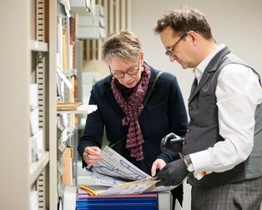
General information
Proposal submission deadline:
1 April and 1 October, 17.00 Swiss local time
English for mathematics, natural and engineering sciences, biology, medicine, psychology, economics and political sciences. In all other research areas, applications can be submitted in one of the official Swiss languages. Special rules apply for political sciences.
Project duration: 12 to 48 months
© SNF / Janosch Abel

Slide 6
Regulations
Project Funding Regulations
General Implementation Regulations for the funding regulations
Funding Regulations of the SNSF

Slide 7
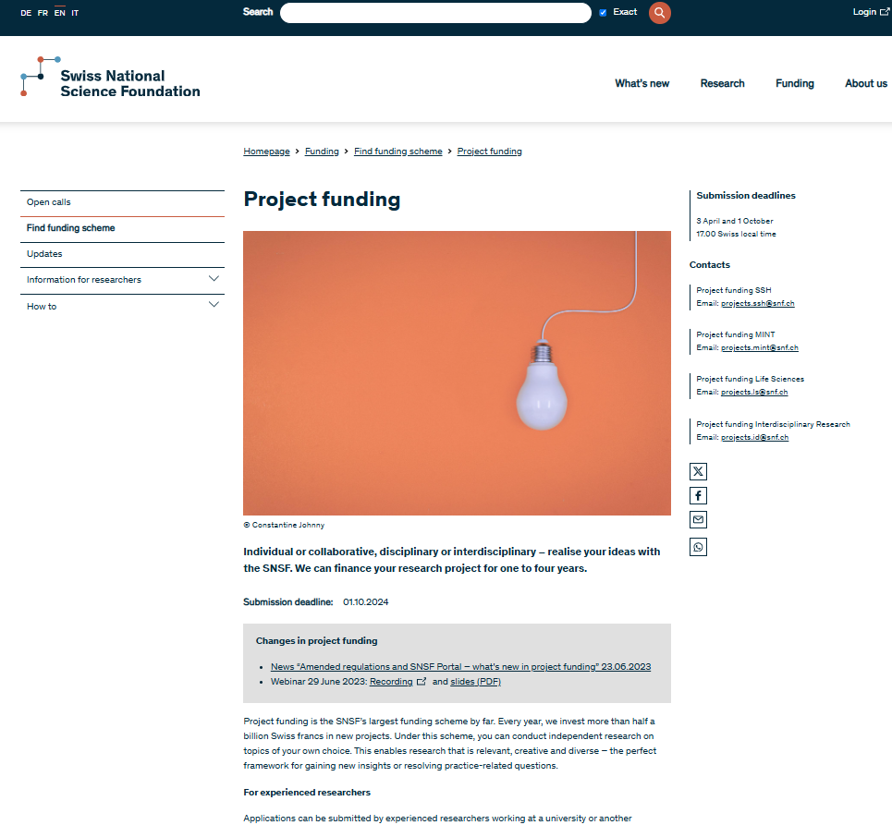
Where to submit
www.portal.snf.ch (not mySNF)
Please note that all applicants and project partners must enter their personal data in the proposal themselves. Only then can you submit your proposal. Invite all applicants and project partners as contributors to the proposal early on, so that they have enough time to create a user account if necessary and to enter their data in the SNSF Portal.
It’s recommended to follow the order of the Data Containers, as there are some technical dependencies among them.
The data management plan (DMP) has only to be submitted in case of funding
www.snf.ch/en/WAvYcY7awAUGolST/funding/projects/projects-in-all-disciplines

Slide 8
Are you eligible for the project funding call as applicant?
Do you…
have a position at a work-time percentage of 50% or more? Alternatively, you have a tenure track position or work as self-employed researcher.
carry out a research project on your own responsibility and can manage the staff involved in it? (independency)
hold a doctorate for four years? Alternatively, you must have worked in research as your main occupation for at least seven years; three of those years will be regarded as equivalent to a doctorate.
work at a university of applied sciences, university of teacher education, cantonal university, federal institutes of technology (ETHs), further accredited higher education institution, or other institution of the higher education sector?
Not eligible
    Employees financed by SNSF grants

Slide 9
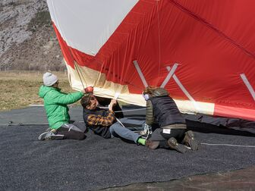
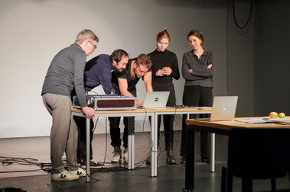

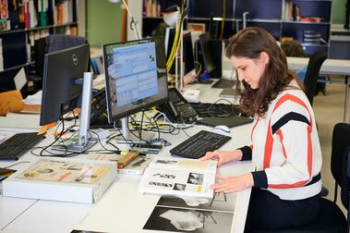
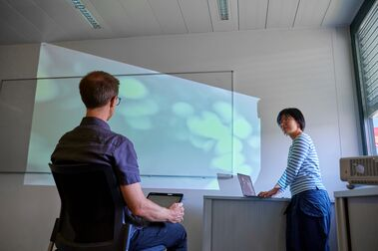

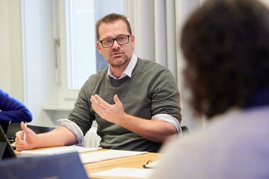

What topics are eligible?
you can conduct independent research on topics of your own choice
disciplinary or interdisciplinary proposals
© SNF / Matthieu Gafsou
© SNF / Janosch Abel
© SNF / Matthieu Gafsou
© SNF / Janosch Abel
© SNF / Janosch Abel
© SNF / Janosch Abel
© SNF / Janosch Abel
© SNF / Matthieu Gafsou

Slide 10

How many ongoing grants are possible at the same time?
Second grant possible if :
  overlapping research projects have clearly different topics, aims, objects of study and research questions,
  All applicants can show that they will make a substantial contribution to all the projects.
Third grant possible in certain cases:
Article 13.1 (regulations on project funding)
  In the project funding scheme, grantees may receive a maximum of three grants from the SNSF for the same funding period, provided at least one grant is for an EU consortium project or has been granted on the basis of a lead agency, Weave or International Con-investigator scheme evaluation. Career funding grants held by persons who are eligible as applicants for the project funding scheme are deemed to be project funding grants in this case.

Slide 11
Which funding schemes count towards the maximum?
Ambizione
Eccellenza
European Partnerships and other multilateral initiatives (except Belmont Forum and & transatlantic platform for social sciences and humanities)
Practice to Science
PRIMA
Projects on health and wellbeing
Project funding
Sinergia
SNSF Professorships
Weave / Lead Agency / International Co-Investigator Scheme
More information can be found here: Funding-Instruments-counting-towards-limit-of-grants-in-project-funding.pdf (snf.ch)

Slide 12
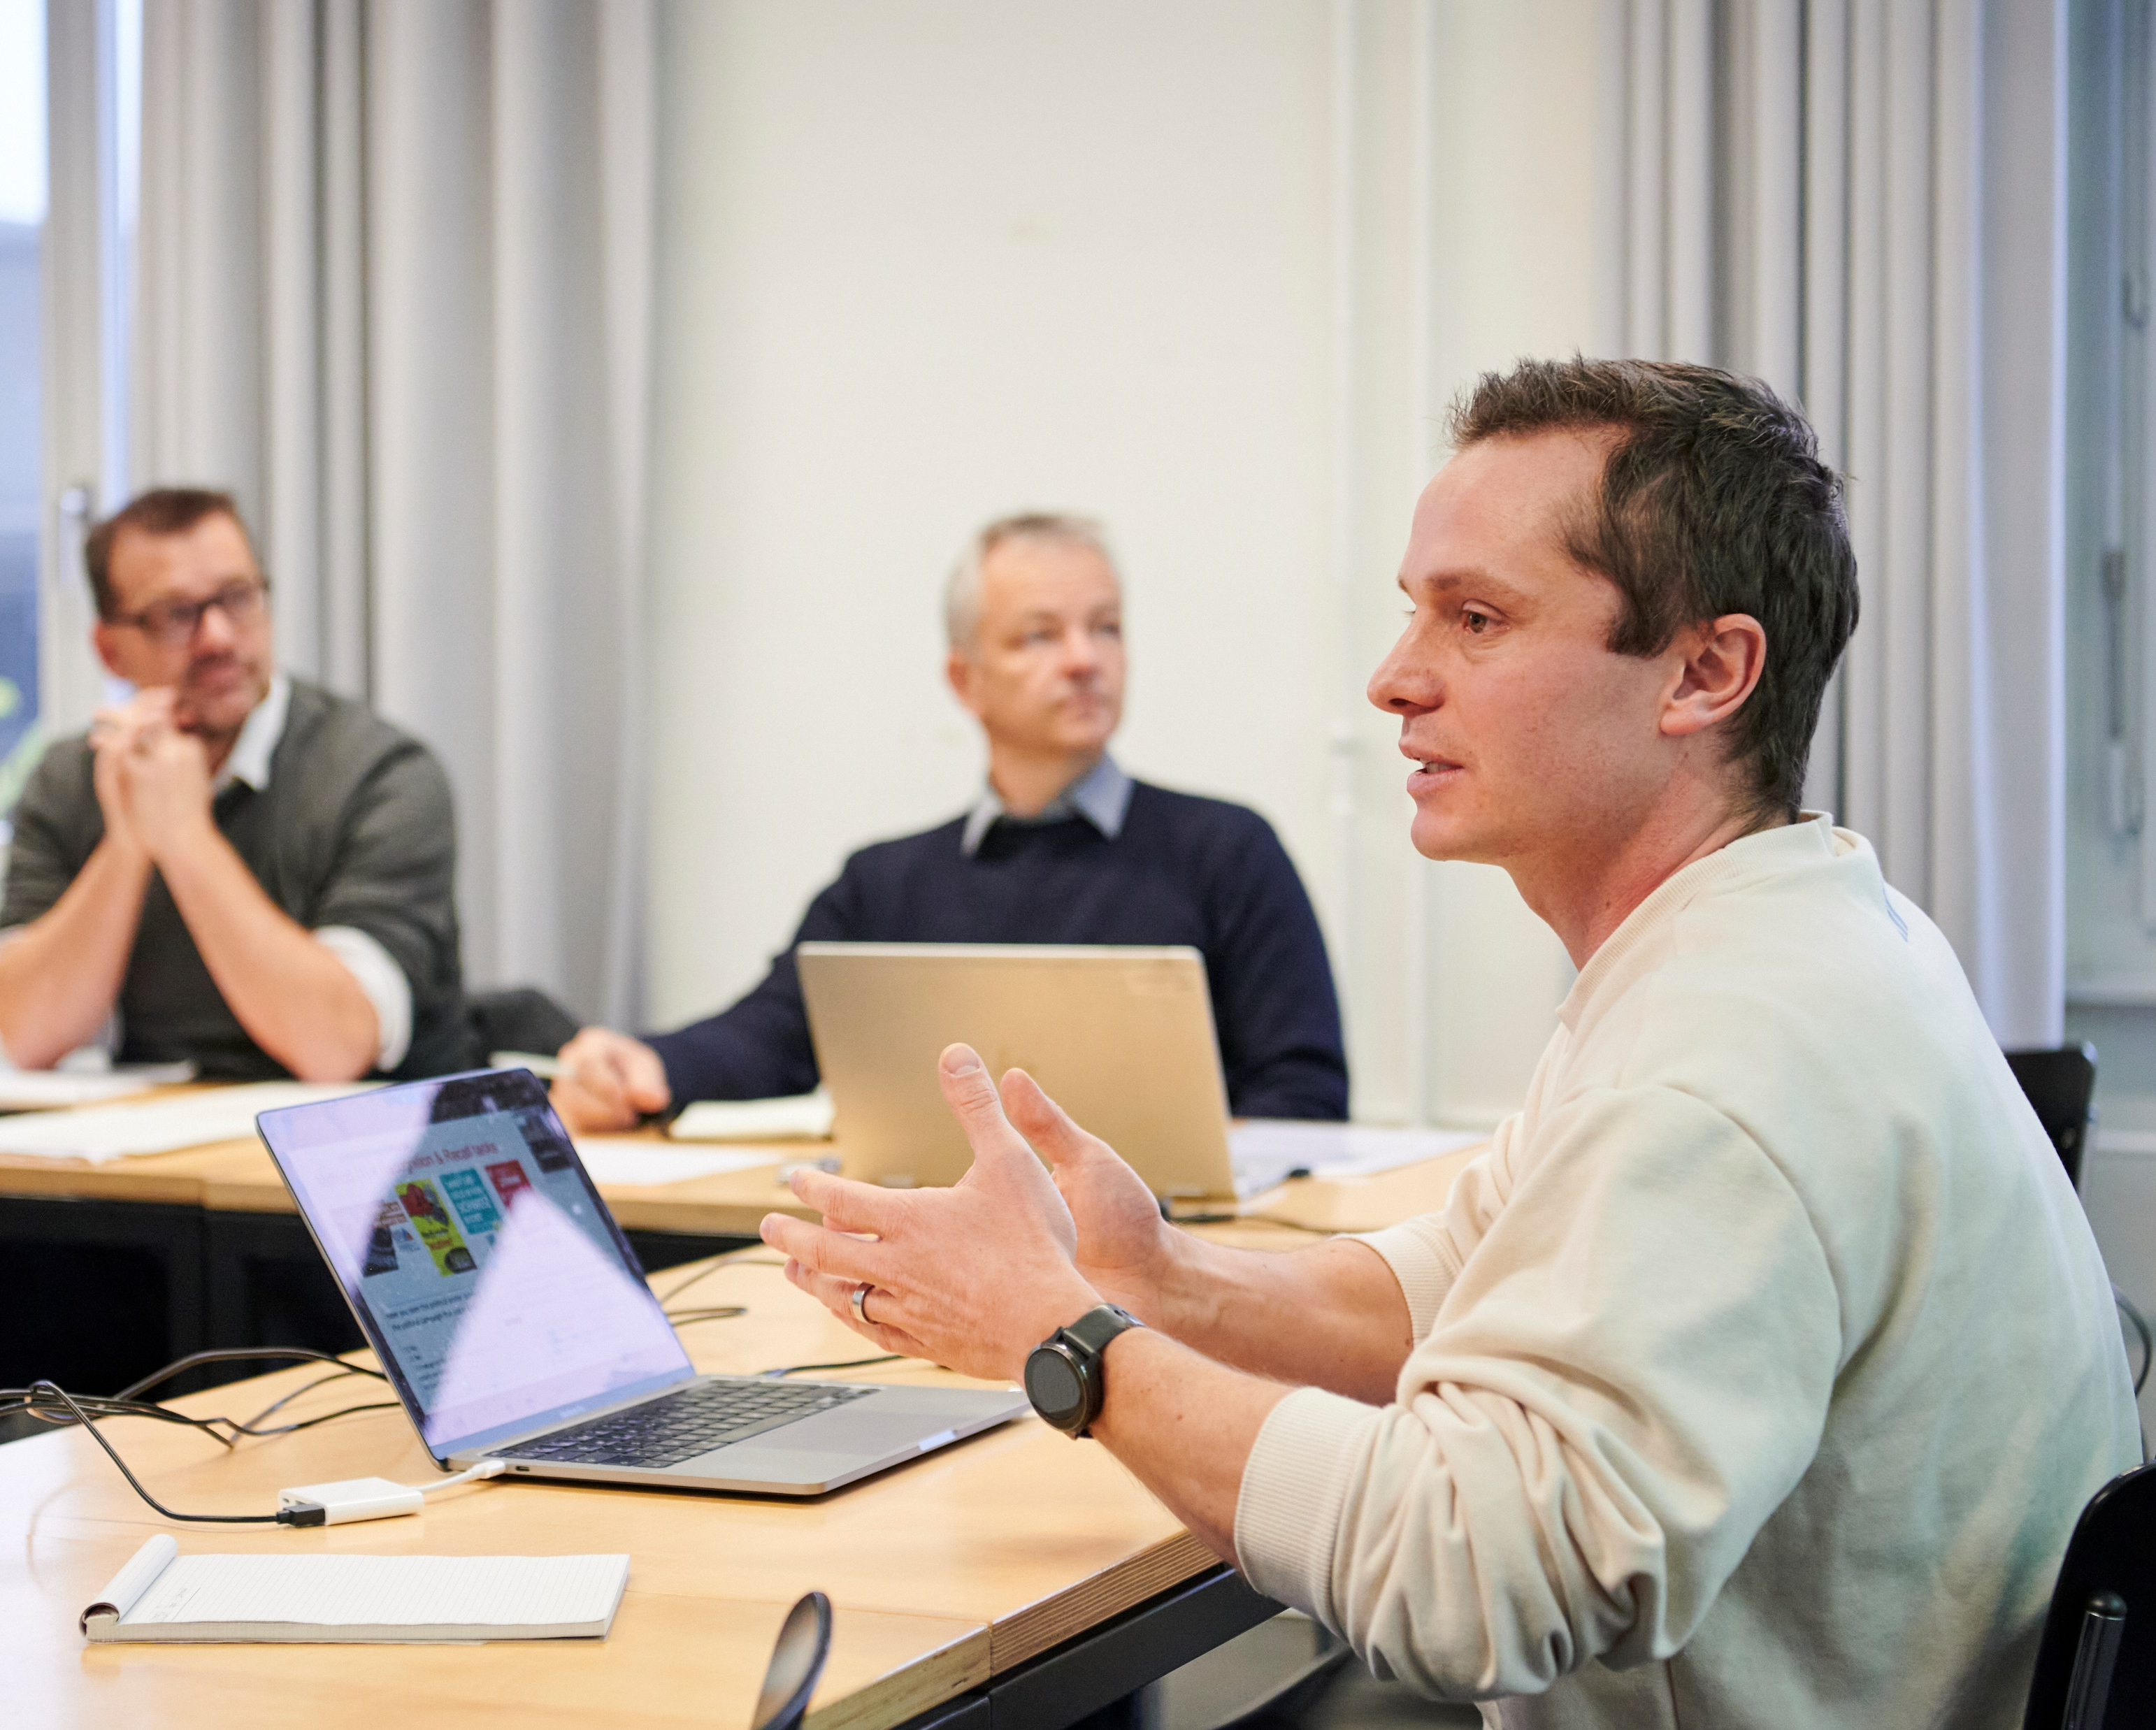
Number of applicants
You can submit a proposal as an individual or together with other researchers.
All applicants must meet the personal requirements and have the necessary scientific qualifications.
© SNF / Janosch Abel

Slide 13
Collaborative projects
What are collaborative projects? (article 9, project funding regulations)
they are submitted by several applicants;
the specialist knowledge and the scientific contribution of two or more applicants are required;
collaboration is essential for achieving the research goals and creates an additional benefit.
Single PI and collaborative projects have similar funding rates
Coordination costs are eligible
In collaborative projects with at least 3 applicants, one applicant may be employed by a research institute outside Switzerland
Hierarchical dependencies between applicants are not permitted
Research plan more space
One additional evaluation criterion exists:
Is the expertise and contribution of all applicants necessary?
Is the collaboration of the different applicants essential to achieve the research goals and creates an added value?
Is the collaboration adequately conceived and organized in view of the joint research objectives?

Slide 14
WEAVE / Lead-Agency / ICIS Agreements
10 multilateral Weave agreements with
Austria - Germany
Belgium (Flanders) - Luxemburg
Belgium (Wallonia) - Poland
Croatia - Slovenia
Czech Republic - Sweden (FORMAS)
6 Bilateral LA agreements with
France (Expression of Interest needed)
Israel
Sao Paulo state
South Africa
South Tyrol province
USA (NSF) (Expression of Interest needed)
5 International Co-Investigator agreements with:
Denmark
Sweden
Norway
Netherlands
Great Britain (only SSH)
Special requirements apply!
Please consult www.snf.ch and/or contact the SNSF office for futher information: projects.international@snf.ch

Slide 15
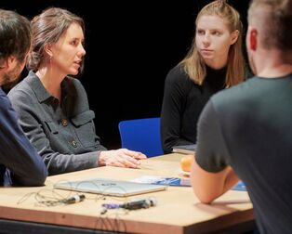
What is the role of project partners and subcontracting?
Project partner(s)
A project partner makes a scientific contribution to the project (no commercial goals)
A project partner is employed at a public, private or commercial research institution/company in Switzerland or abroad.
Project partners may employ personnel
Subcontracting (third parties mandated):
buy-in of services
often from companies
→ it is not mandatory to include project partners or subcontracting
© SNF / Janosch Abel

Slide 16

CV
Your CV is directly linked to your profile in the data container «Team»
You do not have to upload a separate CV document anymore on the portal
© SNF / Janosch Abel

Slide 17
How to submit a rejected project from the Health and Wellbeing Call
Your rejected Health and Wellbeing call proposal will be evaluated as a new project in the project funding scheme.
→ Revision notes are not required

Slide 18
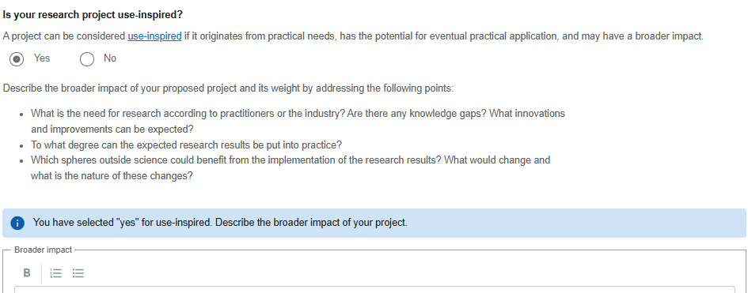
Is the project use-inspired?
The broader impact must be declared directly on the portal in the data container “research plan” (not in the research plan document)

Slide 19
What do I have to consider for the research plan?
# of applicants | Max. page length | Max. characters with spaces
Single PI | 15 pages | 60’000
Collaborative Projects | 17 pages | 68’000
Title, front page, footnotes, illustrations, formulae, tables count towards the maximum
Bibliography does not count towards page maximum
Check the character count on the SNSF Portal which is binding. Document formats may change the coding.
Min. font size 10 and line spacing 1.5
No annexed documents allowed
Structure of the research plan according to guidelines

Slide 20
Budget
Costs covered by grant: personnel, consumables, travel, small non-standard equipment.
Coordination costs for collaborative projects are eligible
Salary of applicants and project partners are not covered
  CHF 250’000.- per applicant and per year
  CHF 1 Mio. per year
Min. CHF 100’000.-
Max: CHF 4 Mio.-
All costs must be justified

Slide 21

Thank you for your attention!
End of recording
If you have further questions, please write an email to projects@snf.ch or call our reception to get transferred to our team +41 31 308 22 22.

